Slide 1
Configure SSRS, build your first SSRS report and deploy it

Slide 2
Prerequisite
SQL Server Database Engine Installed and Database AdventureWorksDW Restored
SQL Server Data Tool Installed
SQL Server Management Studio Installed
IIS Installed and configured

Slide 3
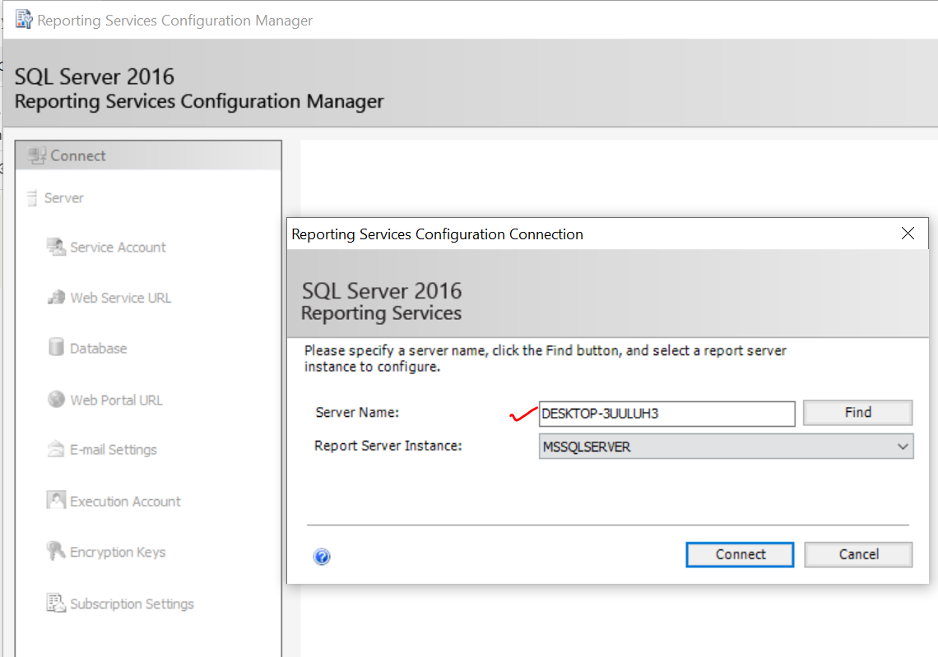
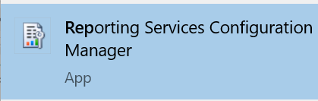
Connect to SQL Server Reporting Services(SSRS)
Press Windows Key,
then search for reporting

Slide 4
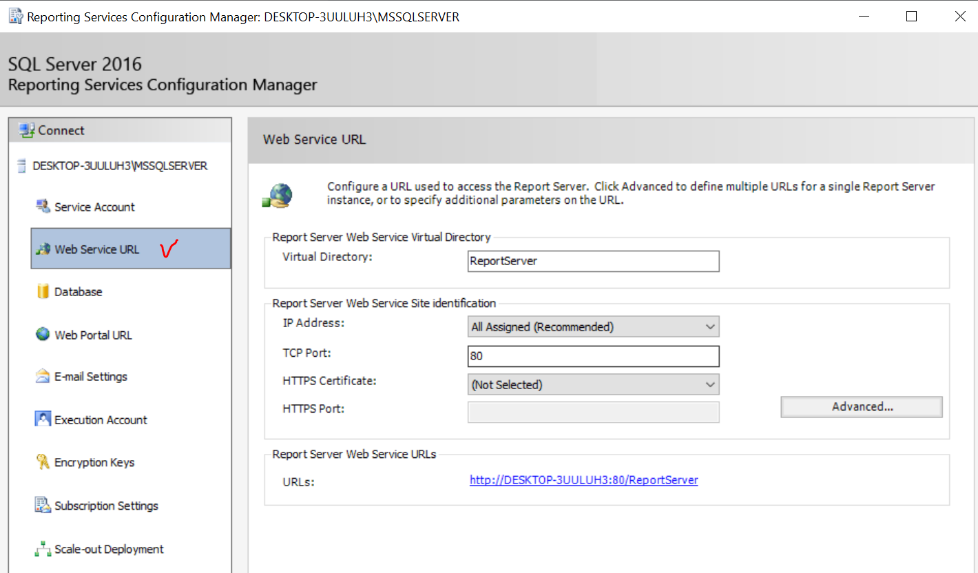
Configure ReportServer site

Slide 5
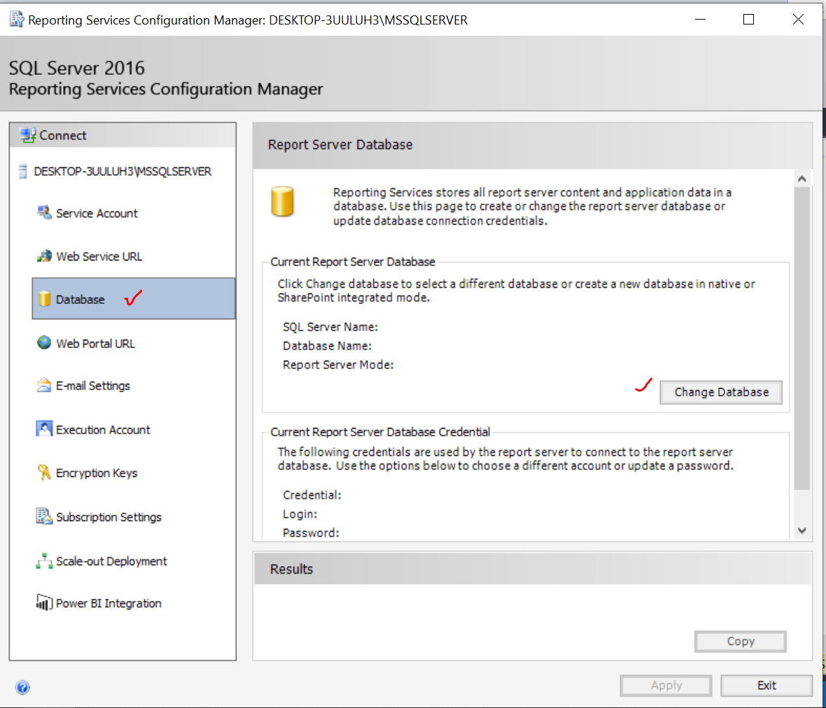
Configure ReportServer and ReportServerTemp db

Slide 6
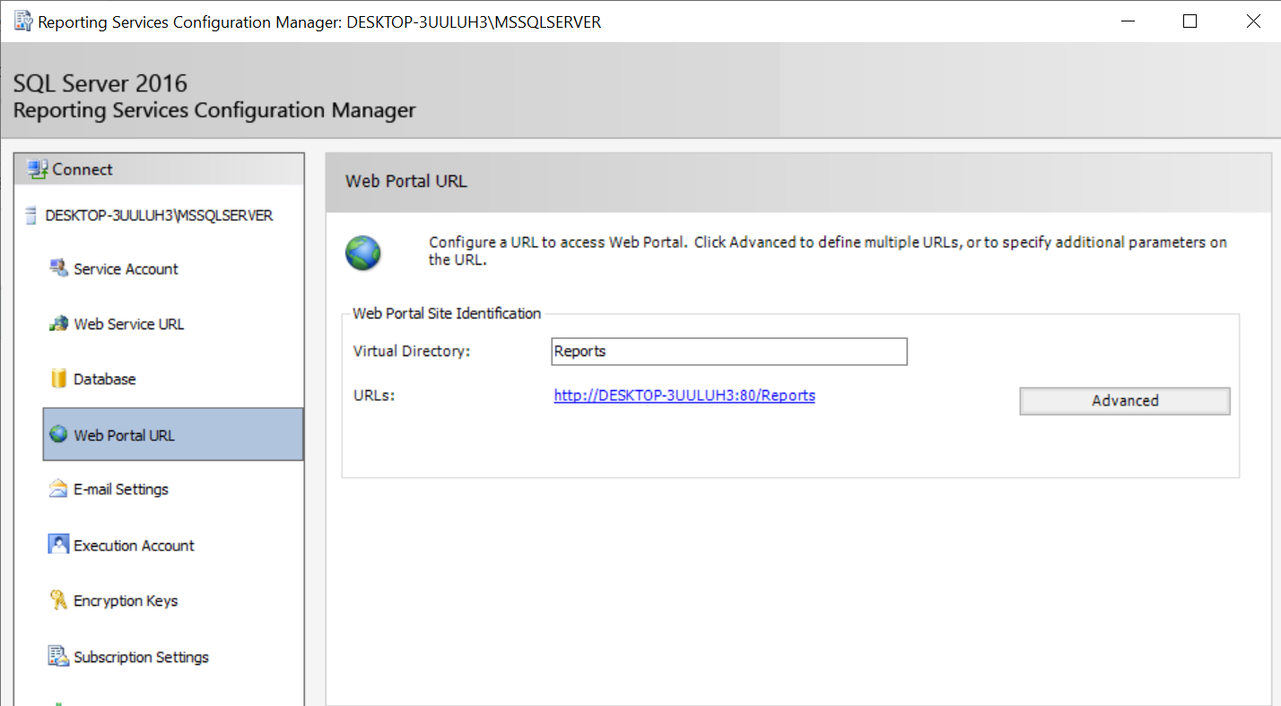
Configure ReportManager site

Slide 7
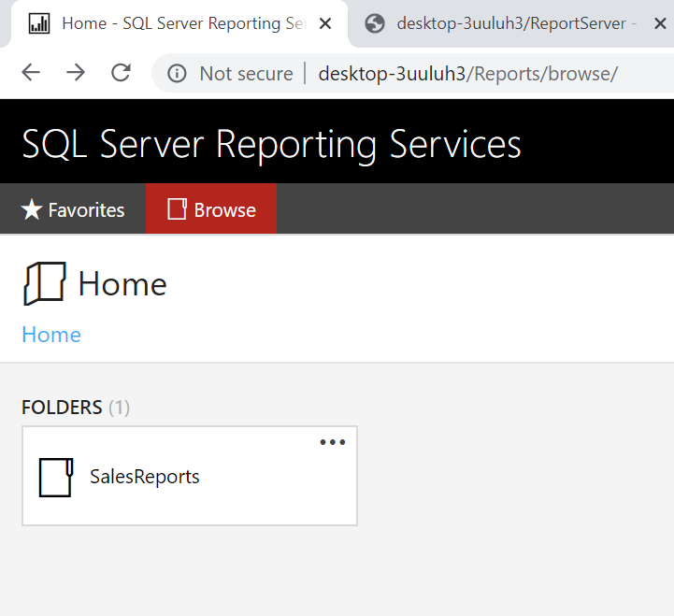
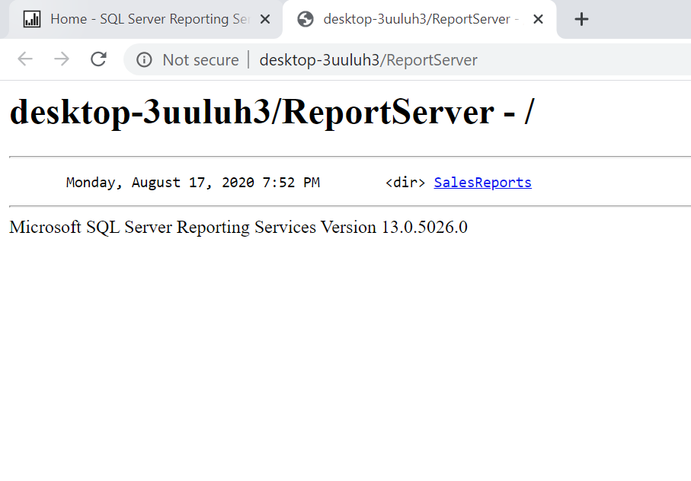
SSRS portals

Slide 8
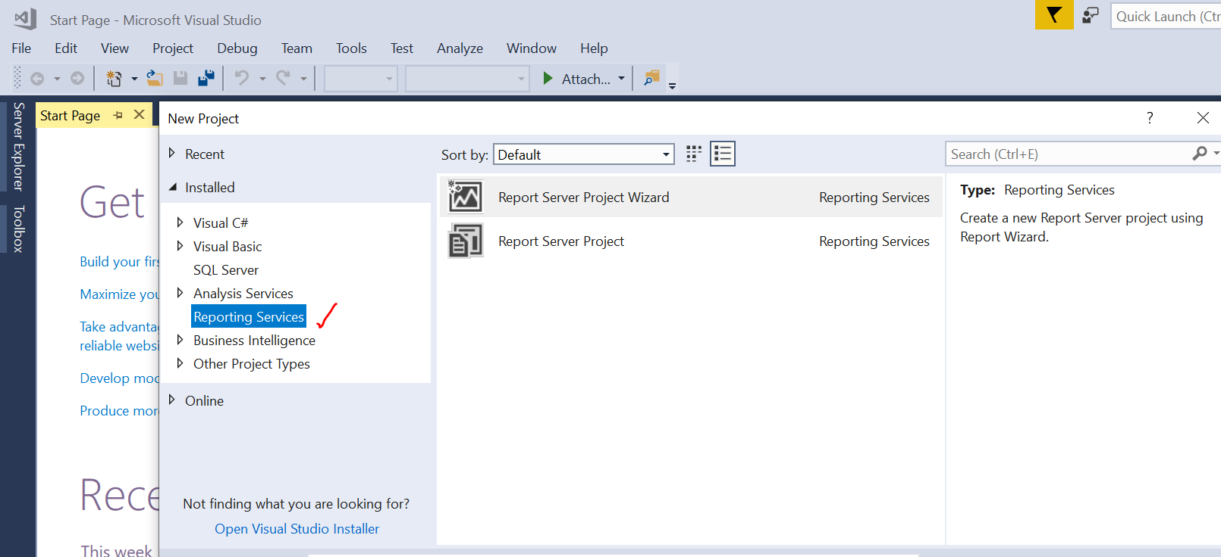
Build your first SSRS report with SSDT

Slide 9
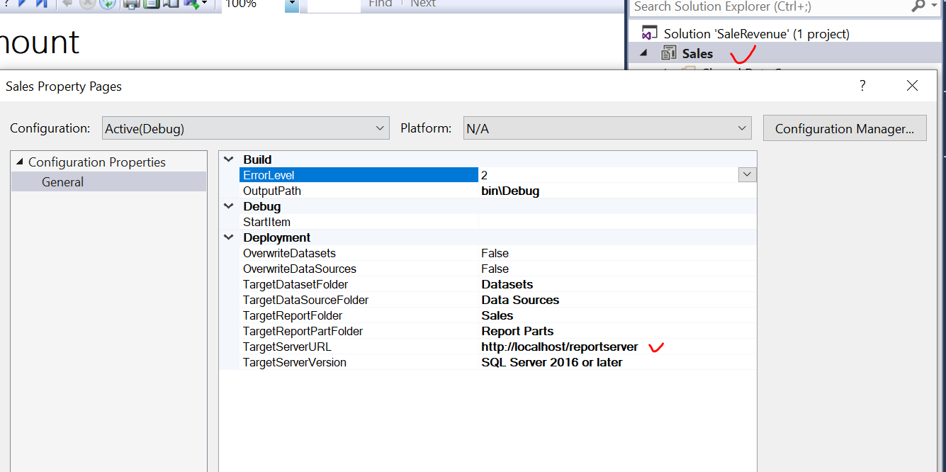
Deploy your SSRS report solution

Slide 10
Thanks for watching!
Please leave a comment if you have any questions!
If you like this video, please hit the below LIKE button and Subscribe it..

